Slide 1
Algebraic Topology and Distributed Computing part three
Maurice Herlihy
Brown University

Slide 2
Read-Write Memory
When can a task be solved
  in read/write memory
  wait-free?
Asynchronous Computability Theorem
  necessary and sufficient conditions

Slide 3
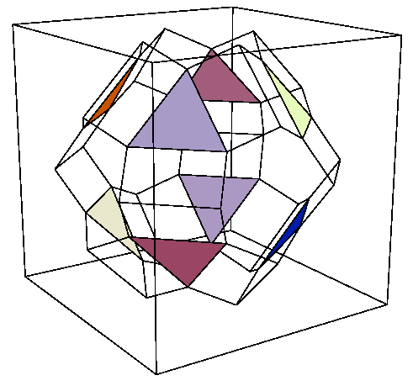
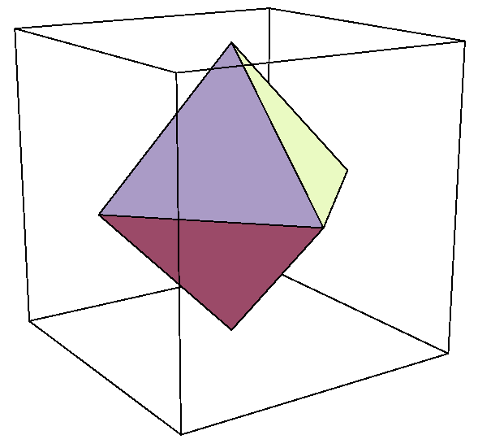
Review
δ
Protocol complex
Δ
Input complex
Output complex

Slide 4
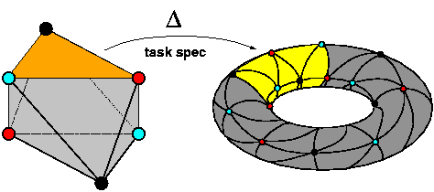
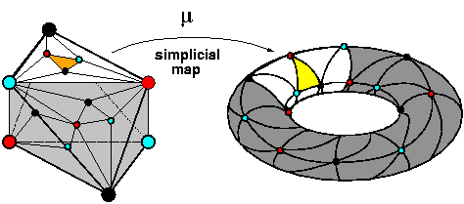
Asynchronous Computability Theorem
A task has a wait-free read/write protocol iff there exists a simplicial map μ
  from subdivided input complex
  to output complex
  that respects Δ

Slide 5
Protocol implies Map
Prove protocol complex n-connected
exploit connectivity to
  embed subdivided input complex into protocol complex
  map protocol complex to output complex
  just like k-set agreement proof

Slide 6
Map implies Protocol
We can reduce any task to “simplex agreement”
start out at corners of subdivided simplex
must rendez-vous on vertexes of single simplex in subdivision

Slide 7
This Talk
Focus on showing that protocol complex is n-connected
elementary algebraic topology
technique extends to other models

Slide 8
Review: Connectivity
A complex C is n-connected if it has no holes in dimension n or less
that is, any map from the n-sphere to C can be extended to the (n+1)-disk

Slide 9
Reasoning about Connectivity
Although connectivity is defined in a continuous way
we can reason about it in a purely combinatorial way ...

Slide 10
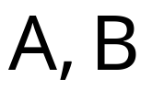


Reasoning about Connectivity
If
  are n-connected
  is (n-1)-connected
  then is n-connected
(Follows from
  Mayer-Vietoris
  Seifert/Van Kampen)

Slide 11
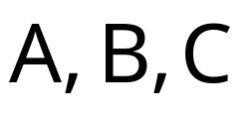

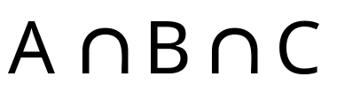

Reasoning about Connectivity
If
  are n-connected
  are (n-1)-connected
  is (n-2)-connected
  then is n-connected
And so on ...

Slide 12
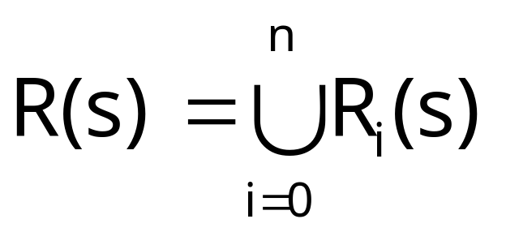
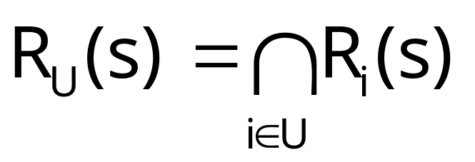
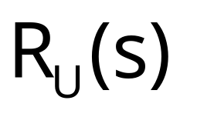
Extended Mayer Vietoris
Let
,
.
is (n-|U|+1)-connected,
If
then R(s) is n-connected.

Slide 13
Critical States
Let P be a property that is
  initially false
  eventually henceforth true
then P has a critical state s where
  P is false in s
  P is true in every successor state to s

Slide 14
Reachable Complex
Let s be a protocol state.
The reachable complex R(s) is
  the subset of the protocol complex
  consisting of global states
  reachable from s

Slide 15
Eventual Connectivity
Let P(s) be the property
  “R(s) is n-connected”
Initially false
  assume by way of contradiction
Eventually henceforth true
  becomes single simplex, n’est-ce pas?

Slide 16
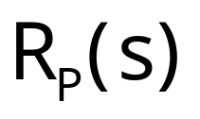
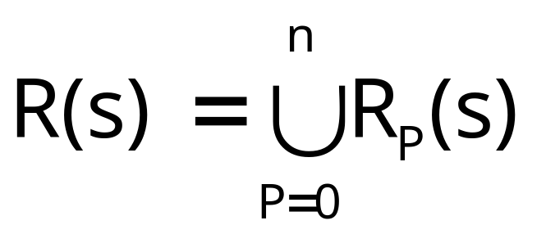
Critical Theory
Let s be a protocol state
  with reachable complex R(s)
if process P takes the next step
  reachable complex becomes
As a result:

Slide 17

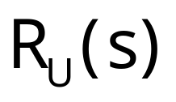
Critical States
If s is a critical state, then
  is not n-connected
  but each is n-connected.
Strategy:
  show each is (n-|U|+1)-connected
  derive contradiction

Slide 18
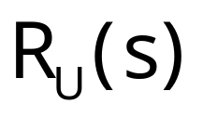
Pending Operations
Each P has a pending operation in s
  a write to m[P]
  a scan of all of m
compute connectivity of
  by case analysis of pending operations

Slide 19
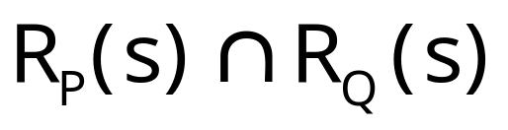
Pending Writes
If P and Q have pending writes in s
  is set of final states where
  all later scans return both values
no one can tell which went first

Slide 20
Pending Writes
Let s’ be state reached from s
  if P writes
  then Q writes
  (or vice-versa)
no one can tell which went first

Slide 21
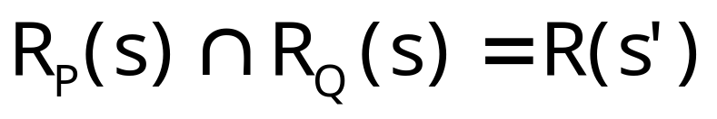
Lemma
All executions in which later scans see both values

Slide 22
Lemma
n-connected because successor to critical state

Slide 23
Lemmas
If all pending operations reads, is n-connected.
Same argument if all pending operations writes.
What if they are mixed?

Slide 24
Pending Reads and Writes
If P has a pending write in s
and Q has a pending scan
  is set of final states where
  no one can tell which went first
but Q can tell!

Slide 25
Pending Reads and Writes
The complex
  is set of executions where
  Q fails in s
  rest run to completion
acts like protocol with
  one less process
  (n-1)-connected by induction

Slide 26
Proof Summary
Assume reachable complex from
  critical state s not n-connected
  successor states (n-1)-connected
Show intersections of
  successor states reachable complexes sufficiently connected
Derive contradiction

Slide 27
Remarks
Proof works for other models too
  critical state exists
  case analysis of pending operations
Alternative approach
  round-by-round induction
  requires structured subset of executions

